Slide 1
Design of NMOS 5TOTA
Presented By
Madhukar Saini

Slide 2
Specifications
Gain : > 30dB
Slew Rate : 5V/µS
Load Capacitance (CL) : 10pF
ICMR : 1V to 1.8V
Gain Bandwidth Product (GBW) : 5MHz
Phase Margin (PM) : > 60°
Temperature in range −40℃ to 125℃
VDD : 2.5V

Slide 3
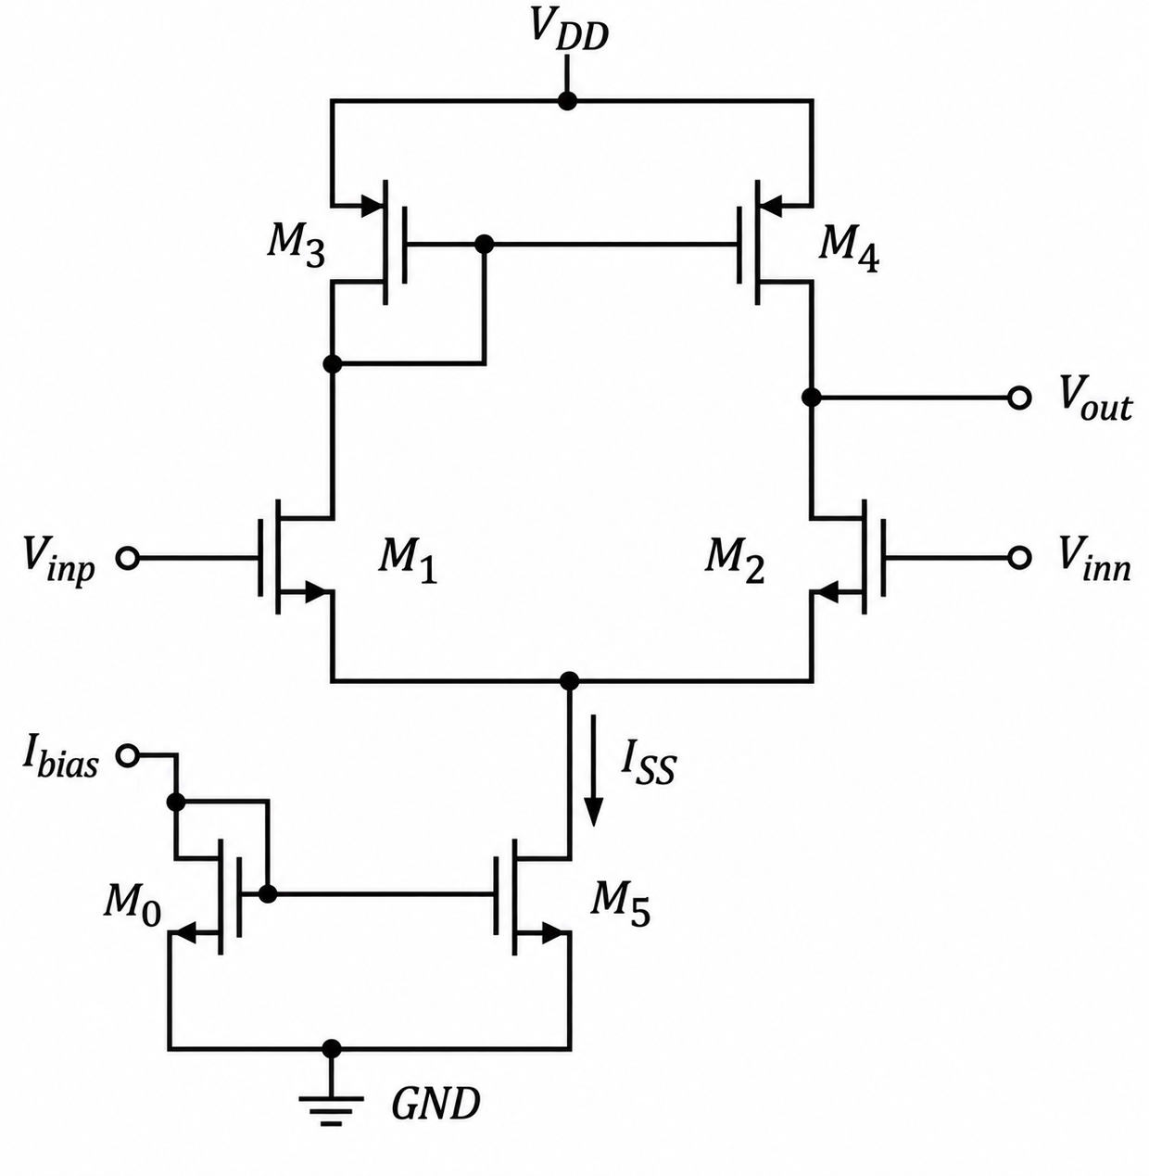
Circuit - 5TOTA
Calculation of I_{SS}
We know,
SWR = I_{ss} /C_{L}
5 (V/μS) = I_{ss} / 10 pF
Therefore,
I_{ss} = 5 (V/μS) x 10 pF
I_{ss} = 50 μA

Slide 4
Sizing of M₁ and M₂
We know
gm = √(2I_{D}μ_{n}C_{ox} (W/L))
Therefore
(W/L) = gm² / (2I_{D}μ_{n}C_{ox})
Since I_{D} = I_{SS}/2 = 50 μA/2 = 25 μA
(W/L) = 7.88 ≈ 8
Here
μ_{n}C_{ox} = 250 μA/V²
μ_{p}C_{ox} = 55 μA/V²
We know,
GBW = 5 MHz
GBW = Gain × 1st pole
1st pole (ω_{pole-1} ) = 1 / (2πR_{out}C_{L})
Gain = −gm_{1,2} × R_{out}
Therefore
GBW = −gm_{1,2} × R_{out} × 1/(2πR_{out}C_{L})
GBW = −gm_{1,2} / (2πC_{L})
Therefore
gm_{1,2} = GBW × 2πC_{L} = 314 μA/V;
Since C_{L} = 10 pF and GBW = 5 MHz

Slide 5
Sizing of M₃ and M₄
Finding (W/L)_{3,4}
For PMOS M₃:
I_{D3} = (½ )μ_{p}C_{ox} (W/L)₃ (V_{SG3} − |V_{THp}|)²
Therefore,
(W/L)_{3,4} = 2I_{D3} / [μ_{p}C_{ox} (V_{SG3} − |V_{THp}|)²]
(W/L)_{3,4} = 1.855 ≈ 2
Here
μ_{n}C_{ox} = 250 μA/V²
μ_{p}C_{ox} = 55 μA/V²
ICMR⁺ = VDD − V_{SG3} + V_{TH1,2}
Here,
VDD = 2.5 V, V_{TH1,2} = 0.8 V
Therefore,
V_{SG3} = VDD − ICMR⁺ + V_{TH1,2}
V_{SG3} = 1.5 V

Slide 6
Sizing of M₀ and M₅
Finding (W/L)_{5,0}
The drain current is
I_{D5,0} = (½)μ_{n}C_{ox} (W/L)_{5,0} (V_{GS}−V_{TH})²
Rearranging,
(W/L)_{5,0} = 2I_{D} / [μ_{n}C_{ox} (V_{GS}−V_{TH})²]
Therefore,
(W/L)_{5,0} = 40
Here
μ_{p}C_{ox} = 250 μA/V²
μ_{p}C_{ox} = 55 μA/V²
ICMR⁻ = Vov_{5,0} + V_{GS1}
Therefore,
Vov_{5,0} = ICMR⁻ − V_{GS1}
For
Vov_{5,0} = 100 mV
and
V_{TH} = 0.8 V
we have
V_{GS1} = 0.9V

Slide 7
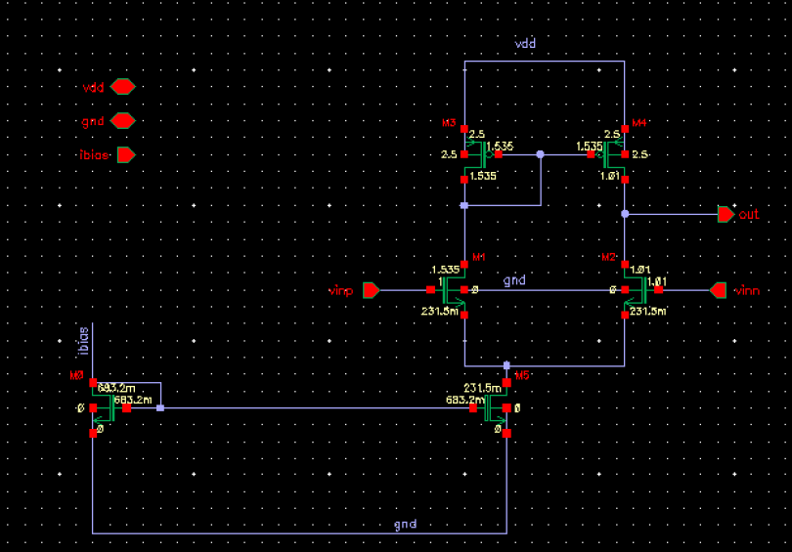
Schematic

Slide 8
Sizes(W/L) of transistors
Sizes of transistors from calculations has adjusted a bit to get results according to the specifications.
Transistor | Size from Calculation in (W/L) | Size adjustment in the Simulation in (W/L)
M₁ and M₂ | 8 | 4μ/500n, f = 2
M₃ and M₄ | 2 | 4μ/1μ, f = 2
M₅ and M₀ | 40 | 5μ/1.4μ, f = 10
Increased input devices size to decrease input offset

Slide 9
Corner Setup
Temperature | -40℃ 27℃ 125℃
Supply | 2.25V, 2.5V, 2.75V
Process | tt,ss,ff,sf,fs

Slide 10
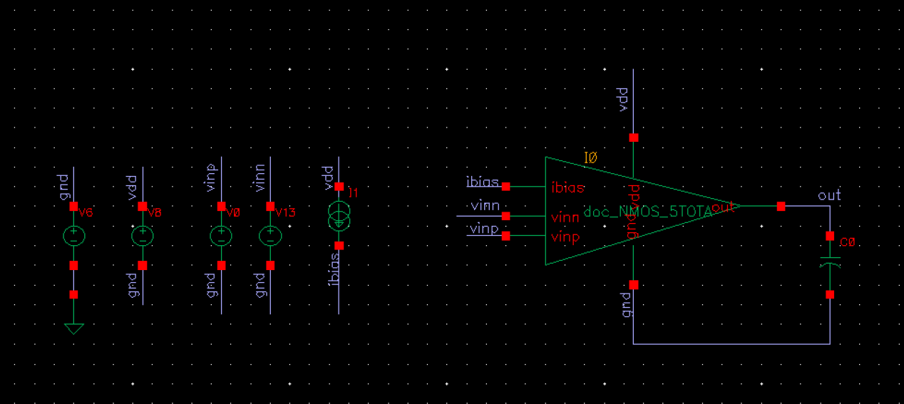
Testbench - DC

Slide 11
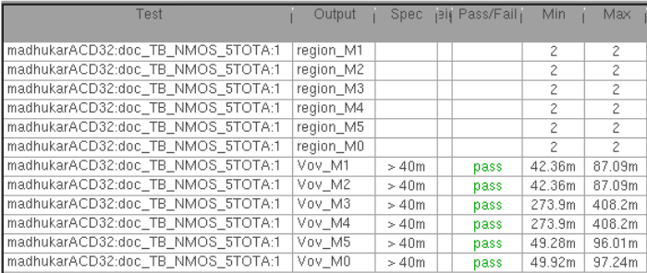
Results - DC (ICMR-)

Slide 12
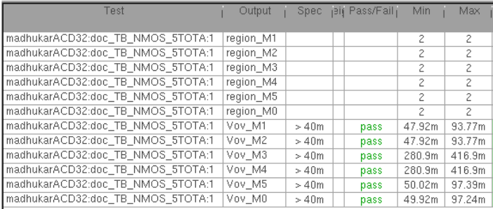
Results - DC (ICMR+)

Slide 13
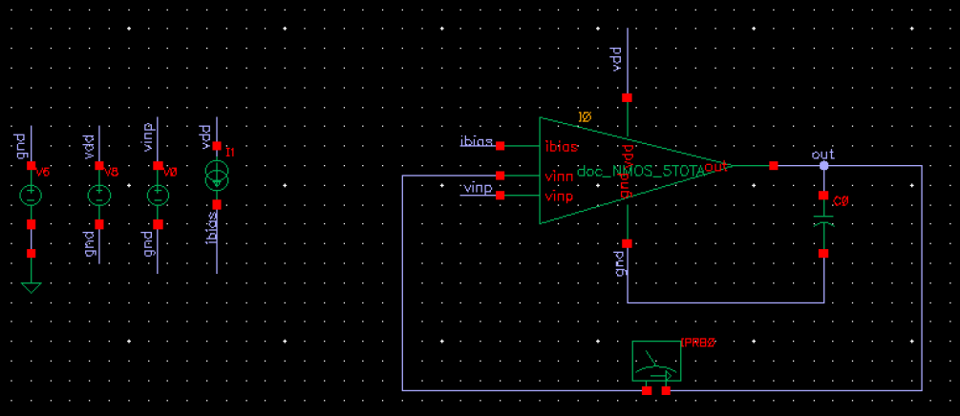
Testbench - Stability

Slide 14
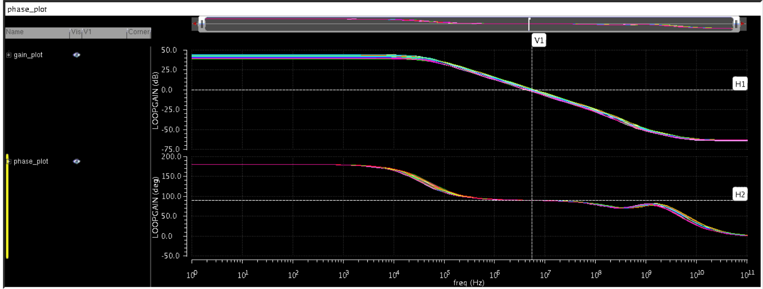

Results - Stability (ICMR-)

Slide 15
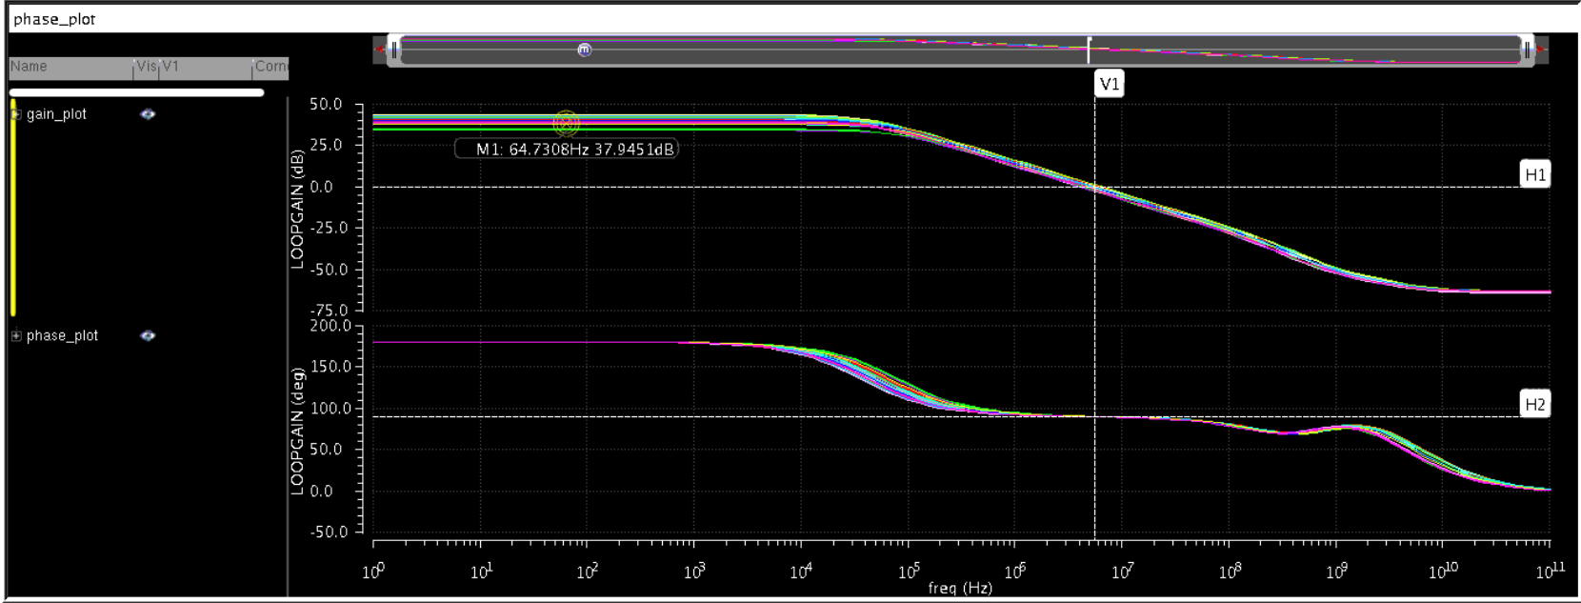

Results - Stability (ICMR+)

Slide 16
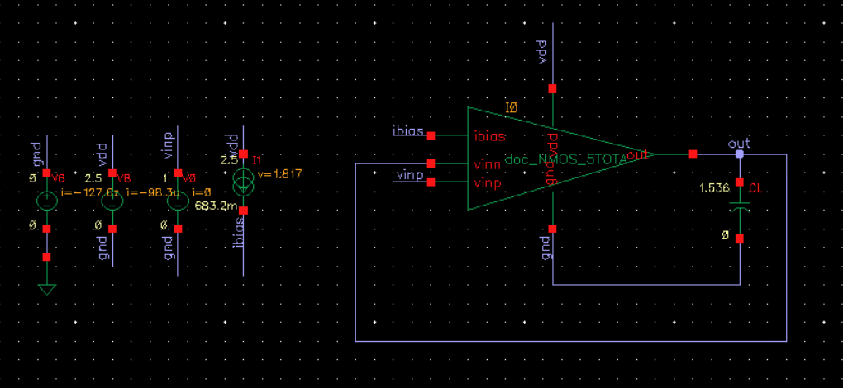
Testbench - PSRR

Slide 17
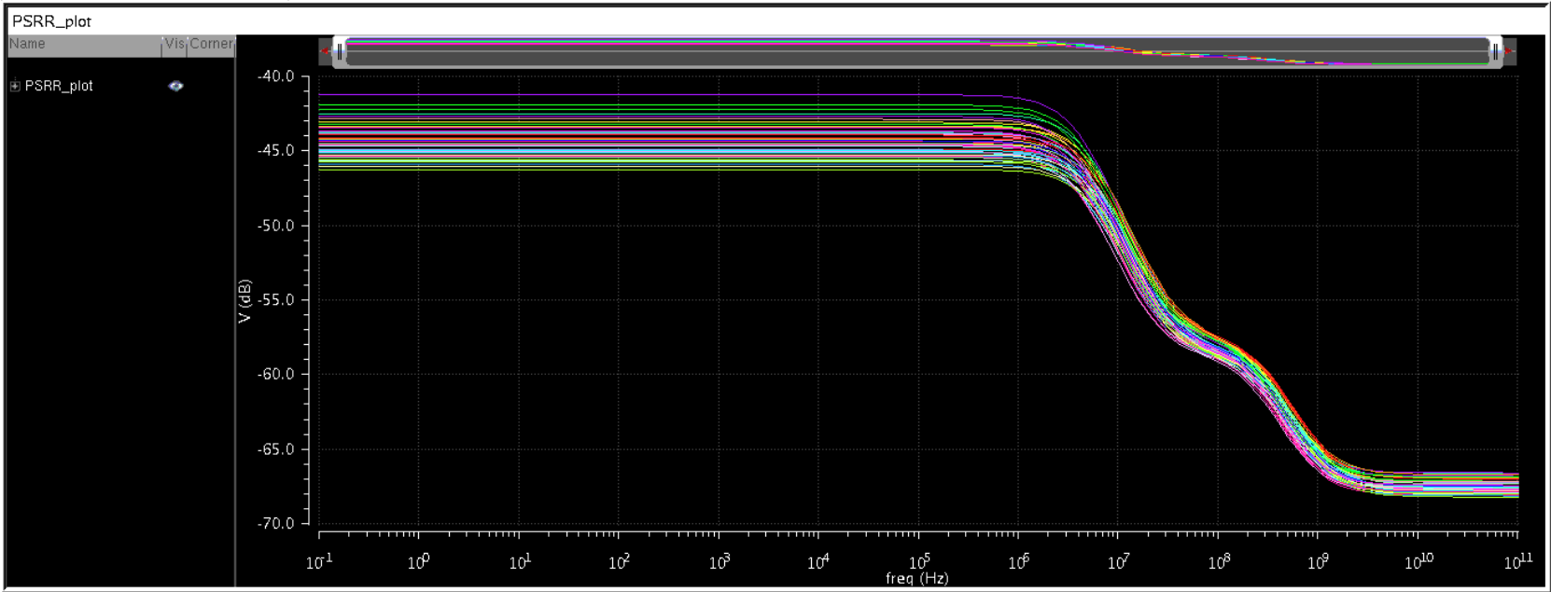
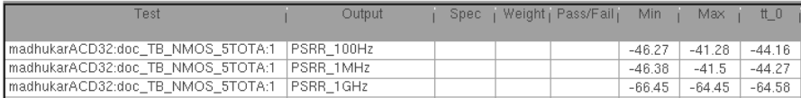
Results - PSRR (ICMR⁻)

Slide 18
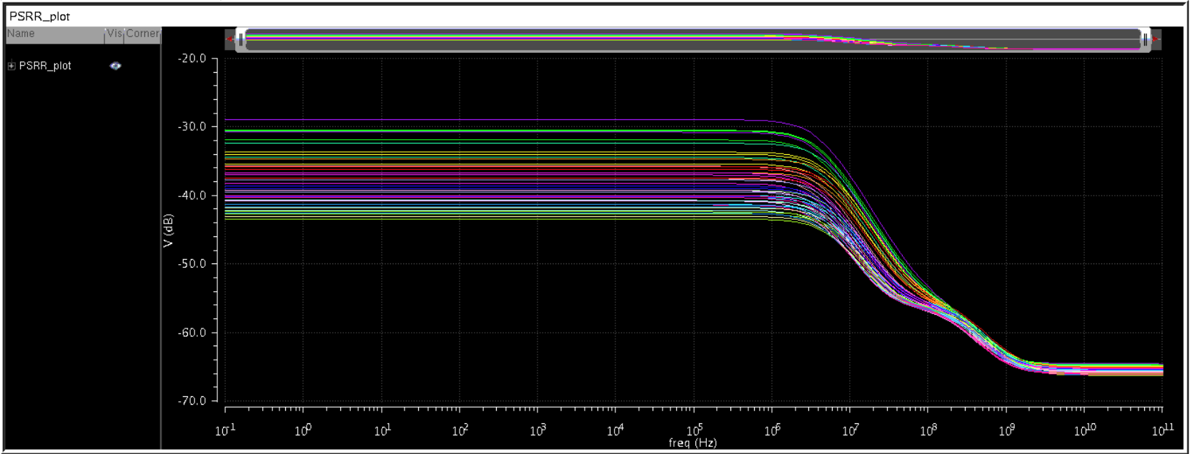
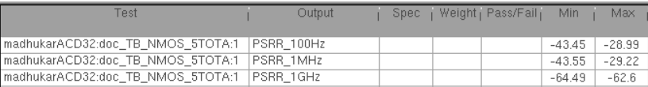
Results - PSRR (ICMR⁺)

Slide 19
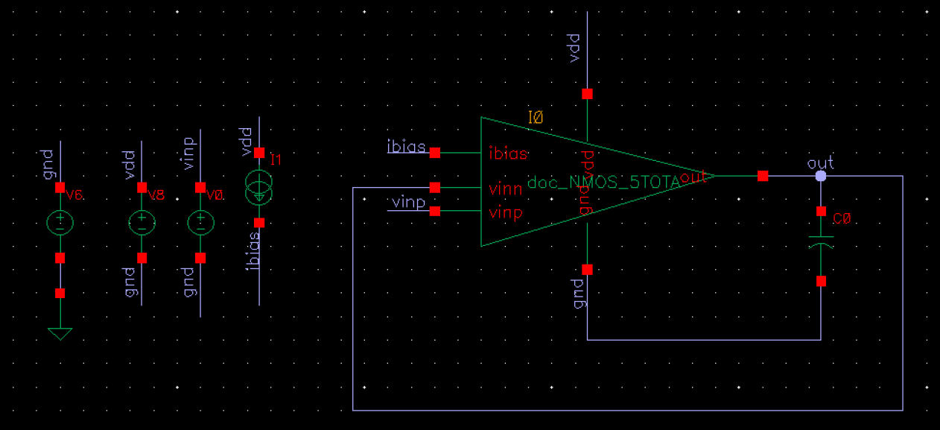
Testbench - Mismatch

Slide 20
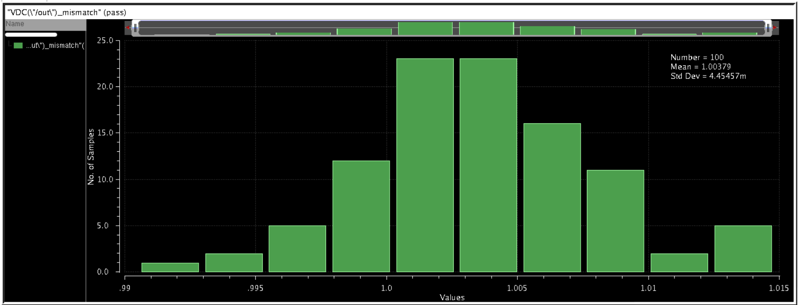
Mismatch Monte Carlo
The simulation is done at 1V reference voltage to positive terminal of its input, negative terminal is varying from 1.004V to 1.015V from the output and the standard deviation here is 4.454mV

Slide 21
Design of 2 Stage Op-amp

Slide 22
Specifications
Gain : >30dB
Gain Bandwidth Product (GBW) : 5 MHz
Slew Rate : 5V/µs
Load Capacitance (CL) : 2pF
ICMR : 1V to 1.8V
Phase Margin (PM) : >60°
VDD : 2.5V

Slide 23
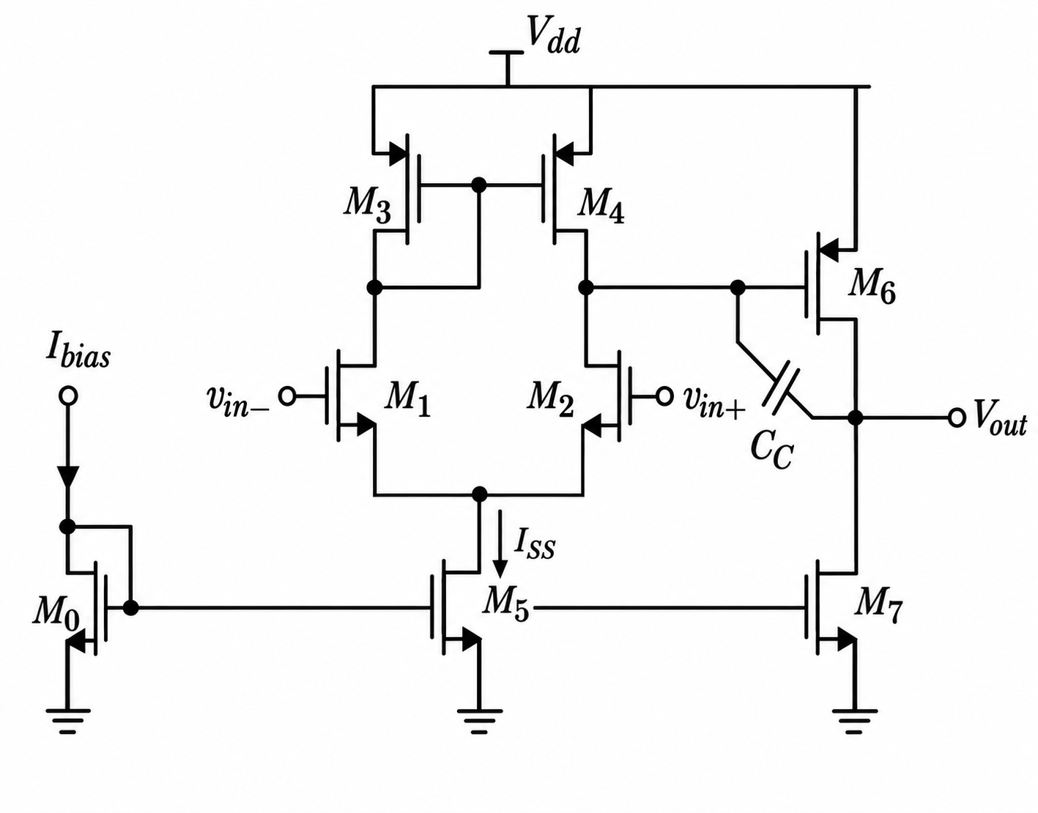
Circuit - 2 Stage Op-Amp

Slide 24
Sizing of M₆ and M₇
To increase the Current and Gm in the second stage we are making
(w/l) of M₆= 4x(w/l) of M₄
(w/l) of M₇= 4x(w/l) of M₅
So multipliers of (w/l) of M₆ and (w/l) of M₇ are increased to 4 by maintaining the ratio of Length to Number of Finger’s Width same in ADE
Note : (w/l) of M₄ to M₆ has changed from 4µ/1µ to 8µ/1µ
Calculation of CC
Generally C_{C} should be greater than 0.22C_{L} for 60° of Phase Margin
The given C_{L} is 10pF, that means
C_{C}>0.22C_{L}
C_{C}>0.22C_{L}=0.22*2pF=440fF
But in simulation since the I_{ss} is taken from 5T OTA Design the C_{C} was adjusted to 5pF

Slide 25
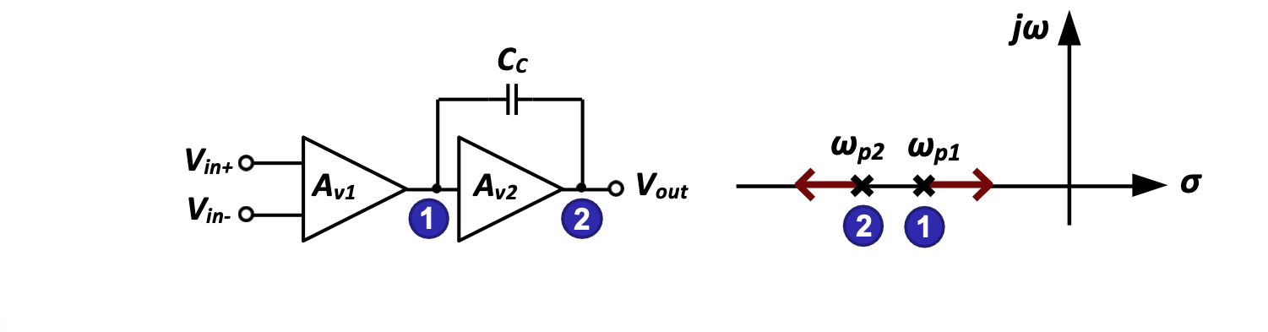
Miller Compensation
The compensation capacitor (C_{C}) is connected between the output of the first stage and the output of the second stage.
Due to the Miller effect, the effective capacitance at the first-stage output node increases.
This creates pole splitting, separating the dominant pole from the higher-frequency pole.
Pole splitting improves the stability and phase margin of the two-stage op-amp.
Miller Approximation:
C_{in} = C_{C}(1-A_{V2}) ≈ C_{C}(1+|A_{V2}|) (at node 1)
C_{out} = C_{C}(1-(1/A_{V2})) ≈ C_{C}(1+(1/(|A_{V2}|)) (at node 2)

Slide 26
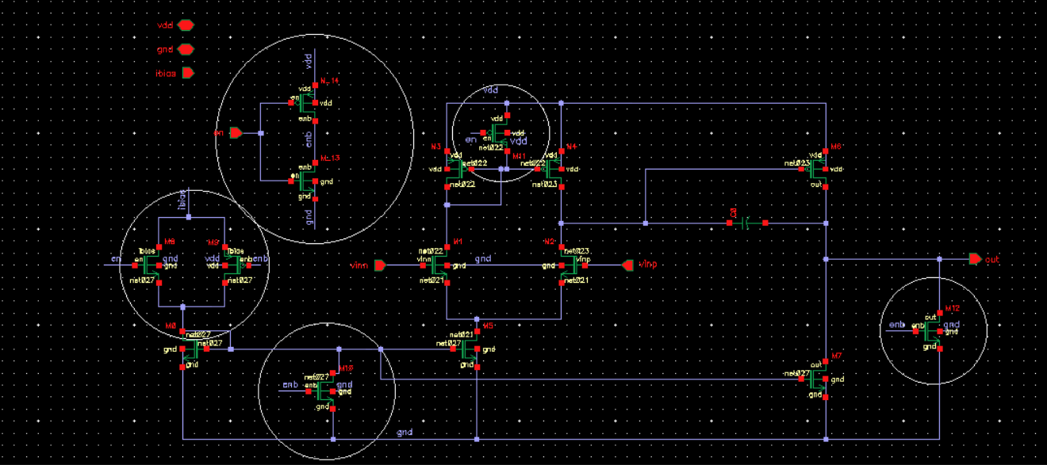
Schematic
Inverter
Switch
Transmission Gate
Switch
Switch

Slide 27
Power-Down & Enable Control in Two-Stage Op-Amp
Inverter (Control Signal Generation): Generates complementary control signals from a single active-high digital enable pin (en → enb), synchronizing all NMOS and PMOS switches simultaneously.
Transmission Gate (Bias Isolation): Placed in series with the input bias line (Ibias​) to disconnect external current feed during sleep mode without causing threshold voltage drops (Vth​).
Node Clamp/Pull Switches: During power-down (enb = High), the 3 shunt switches turn ON to pull NMOS gates to GND, PMOS gates to VDD​, and the output to GND, completely shutting off all current paths (Vgs​=0 V) and preventing floating nodes.

Slide 28
Sizes of Components
Sizes of components from calculations has adjusted to get results according to the specifications
Transistor | Size from Calculation in (W/L) | Size adjustment in the Simulation in (W/L)
M₁ and M₂ | 8 | 4µ/500n, nf = 2
M₃ and M₄ | 2 | 4µ/1µ, nf = 2
M₅ and M₀ | 40 | 5µ/1.4µ, nf = 10
M₆ | 32 | 8µ/1µ, nf = 2, m= 4
M₇ | 160 | 5µ/1.4µ, nf = 10, m= 4

Slide 29
Corner Setup
Temperature | -40°C 27°C 125°C
Supply | 2.25V 2.5V 2.75V
Process | tt,ss,ff,sf,fs

Slide 30
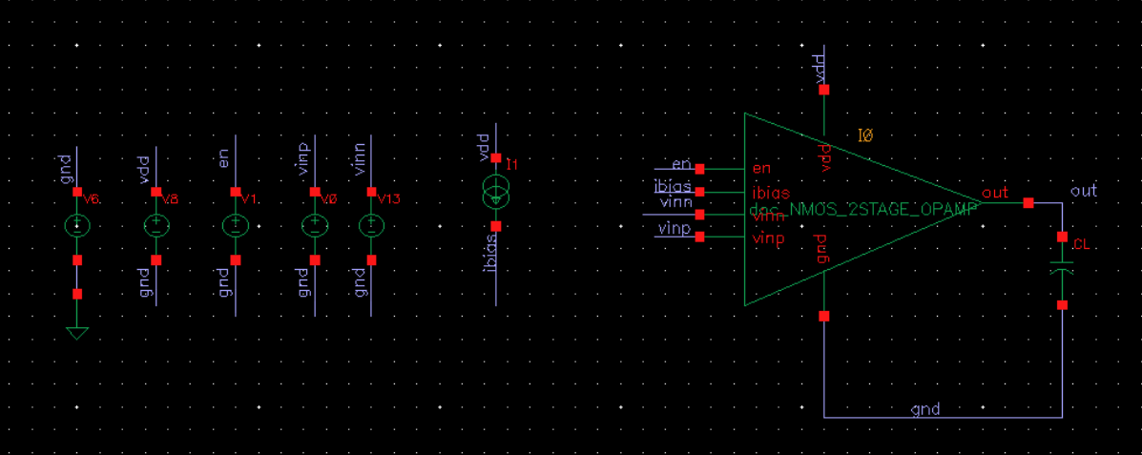
Testbench - DC

Slide 31
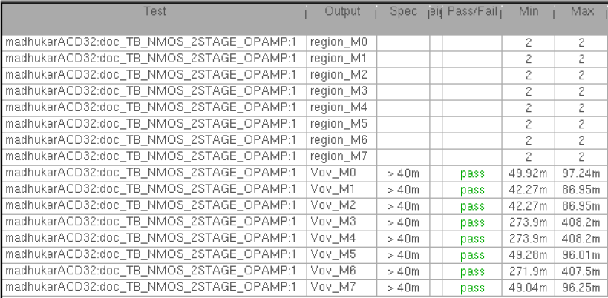
Results - DC (ICMR⁻)

Slide 32
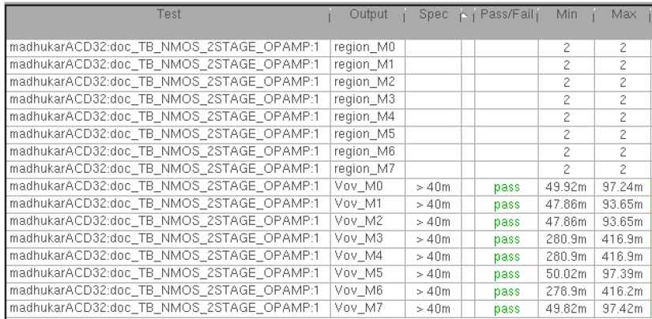
Results - DC (ICMR⁺)

Slide 33
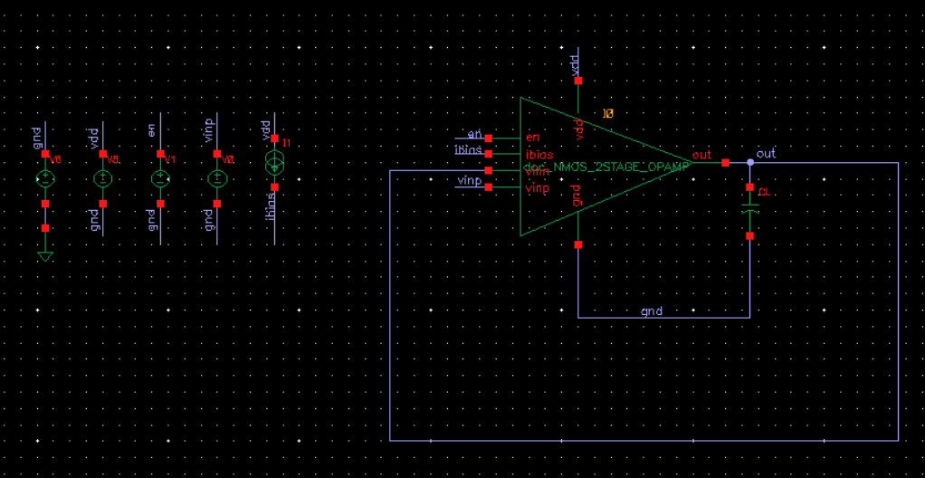
Testbench - PSRR

Slide 34
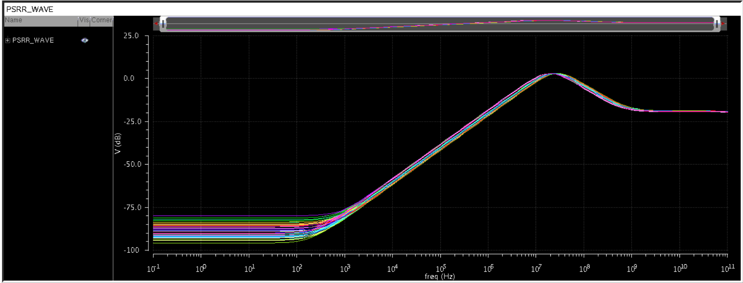
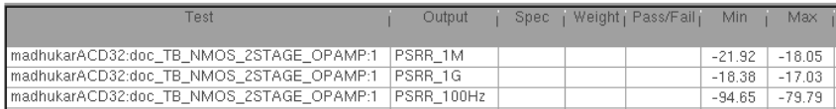
Results - PSRR (ICMR⁻)

Slide 35
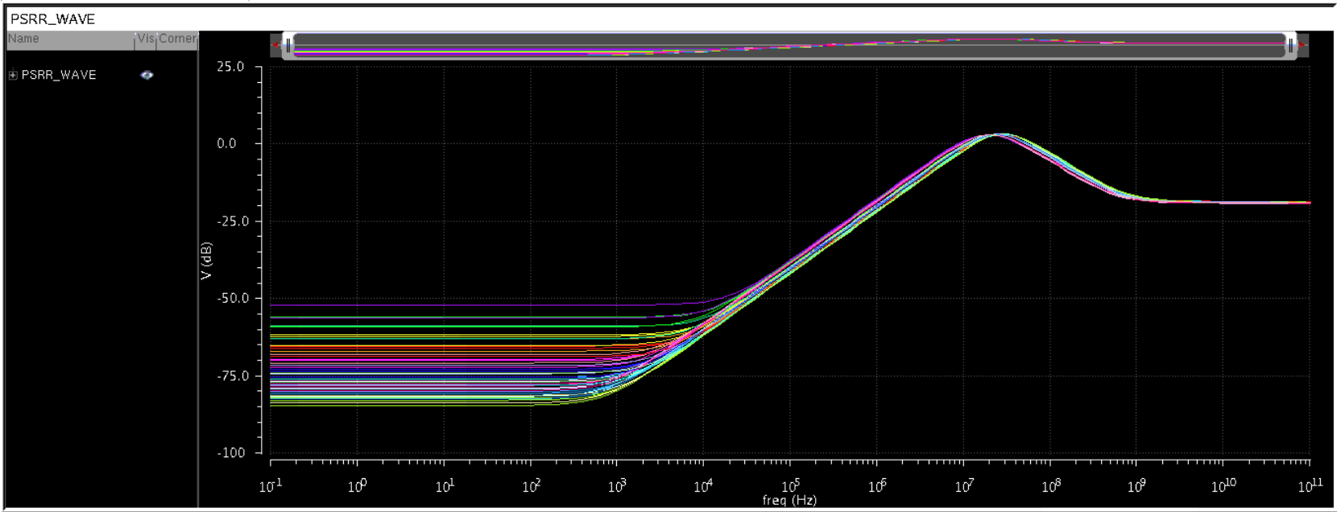
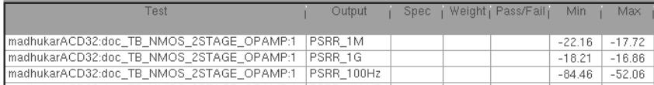
Results - PSRR (ICMR⁺)

Slide 36
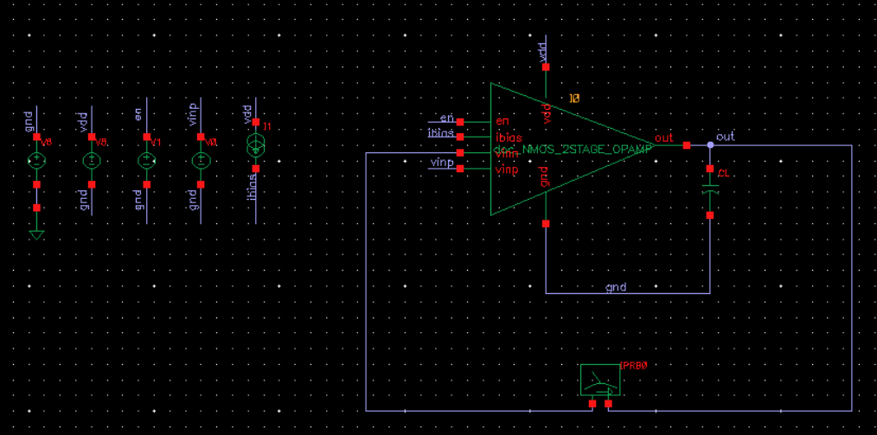
Testbench - Stability

Slide 37
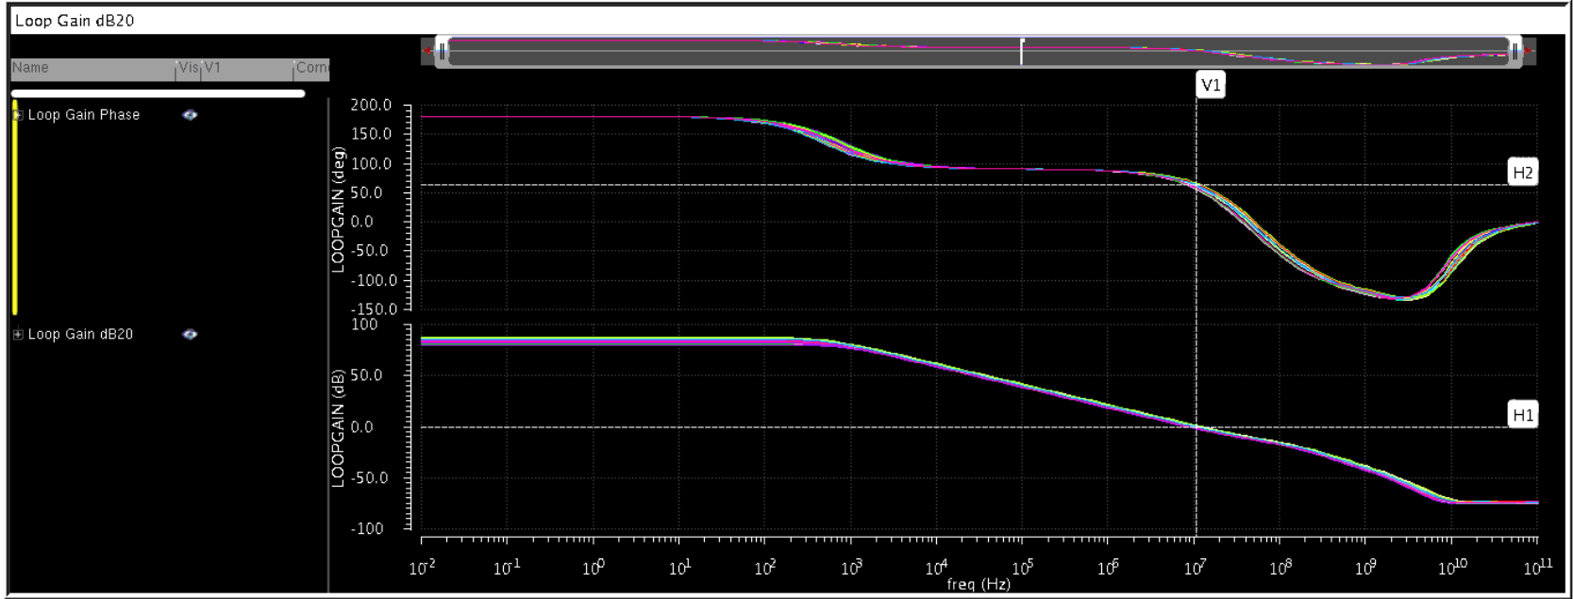
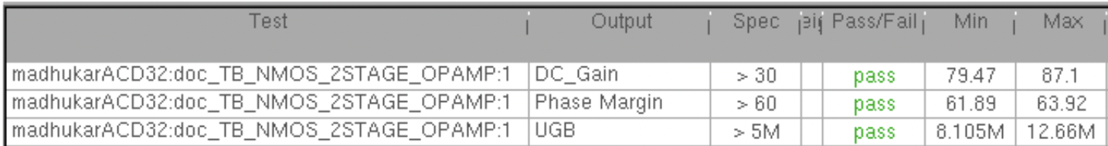
Results - Stability (ICMR⁻)

Slide 38
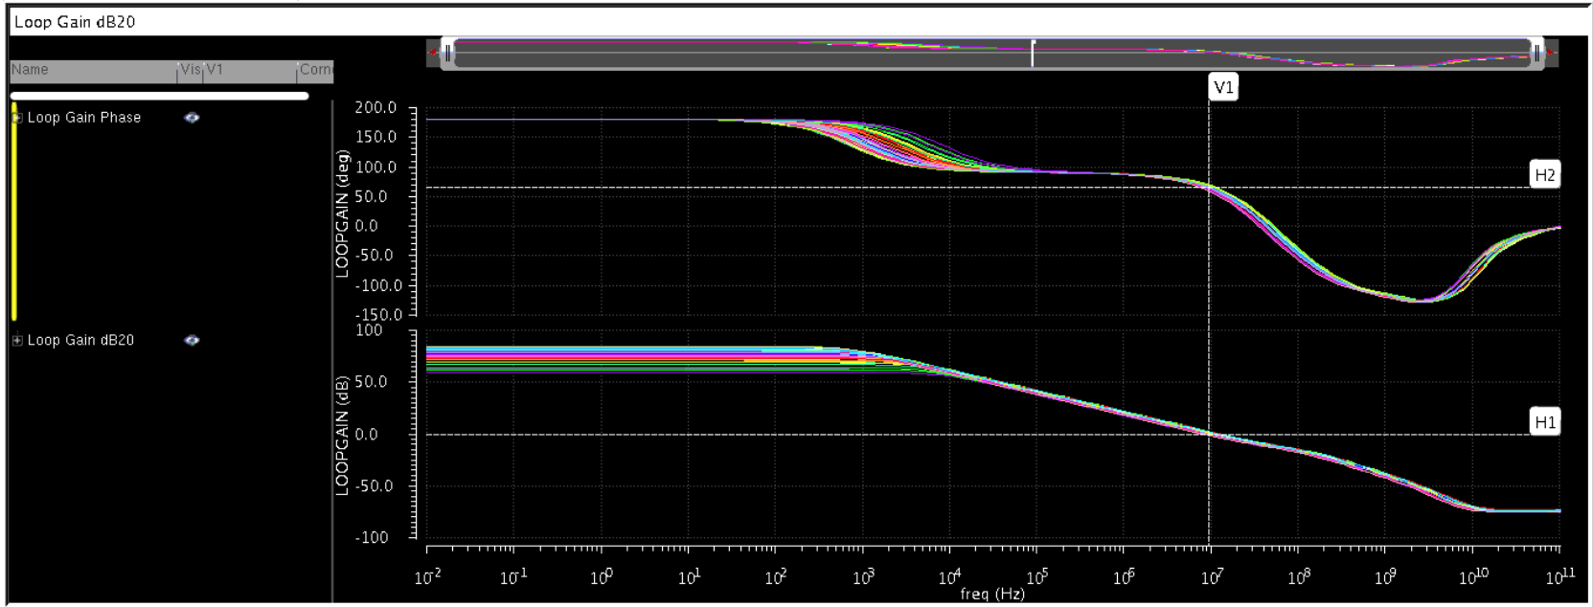
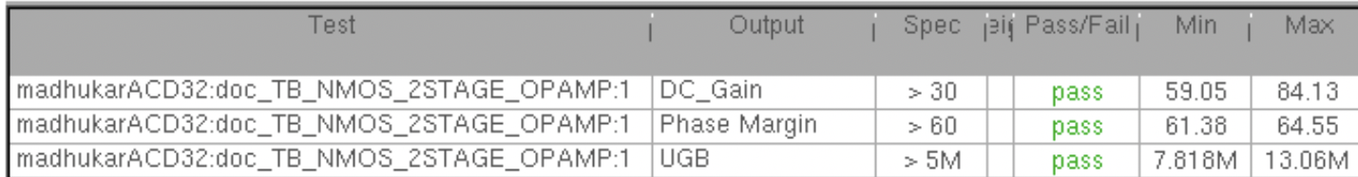
Results - Stability (ICMR⁺)

Slide 39
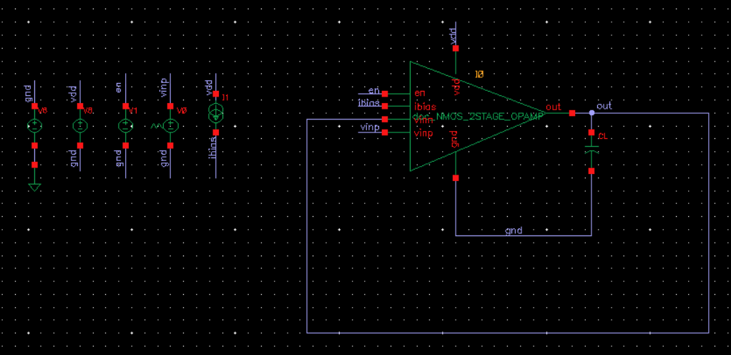
Testbench - Transient Analysis

Slide 40
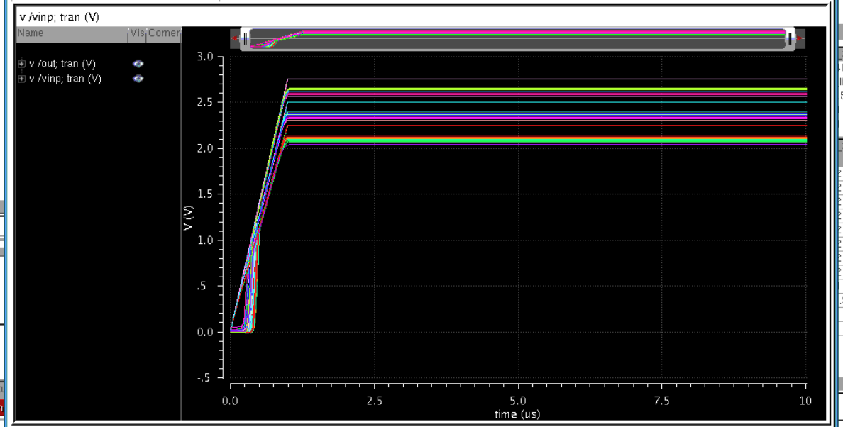
Transient Response
Here the VDD is changing to 2.25V, 2.5V and 2.75V from 0V in 0S to 1uS, where we are not seeing any ringing effect in output

Slide 41

Testbench - Monte Carlo

Slide 42
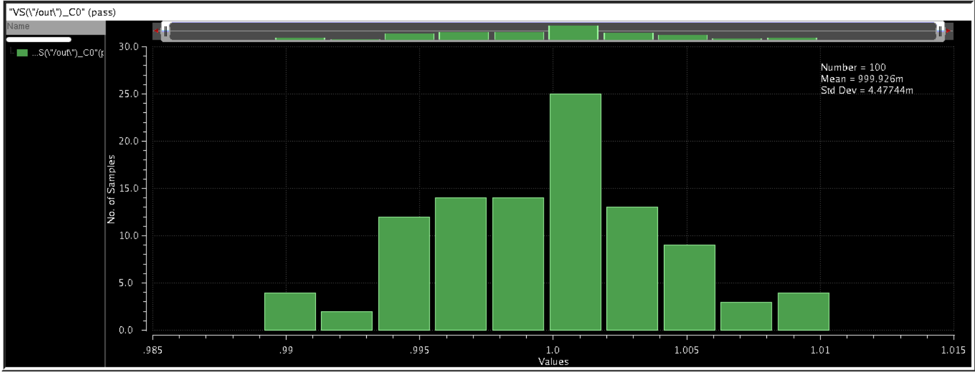
Mismatch Monte Carlo
The input is varying from 1.011V to 999.9mV, where the Standard Deviation is 4.477mV

Slide 43
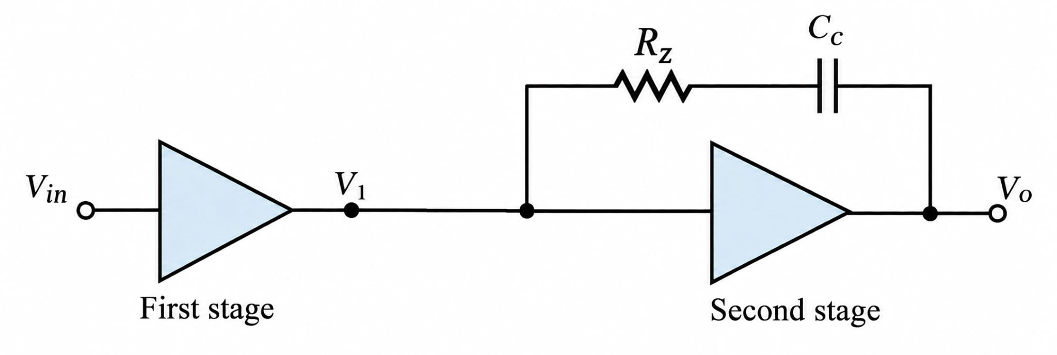
Adding LHP zero
C_{C}​ provides feedback from the output to the first-stage output.
Due to the Miller effect, it appears as a large capacitance at the first stage:
Ceff≈C_{C}(1+∣A₂∣)
This creates a low-frequency dominant pole, separating the poles and improving stability.
Why does a zero appear?
C_{C} provides a direct feed-forward path from V₁ to V_{o}, in addition to the normal second-stage path through gm₂.
The interaction of these two paths introduces a zero in the transfer function.
With only C_{C} (R_{z}=0), this zero is in the right-half plane (RHP) and adds phase lag, reducing phase margin.
Key idea
Adding R_{z} in series with C_{C} modifies the feed-forward path.
By choosing R_{z} appropriately, the RHP zero can be removed or moved to the left-half plane (LHP).
The LHP zero provides positive phase lead, which improves phase margin.

Slide 44
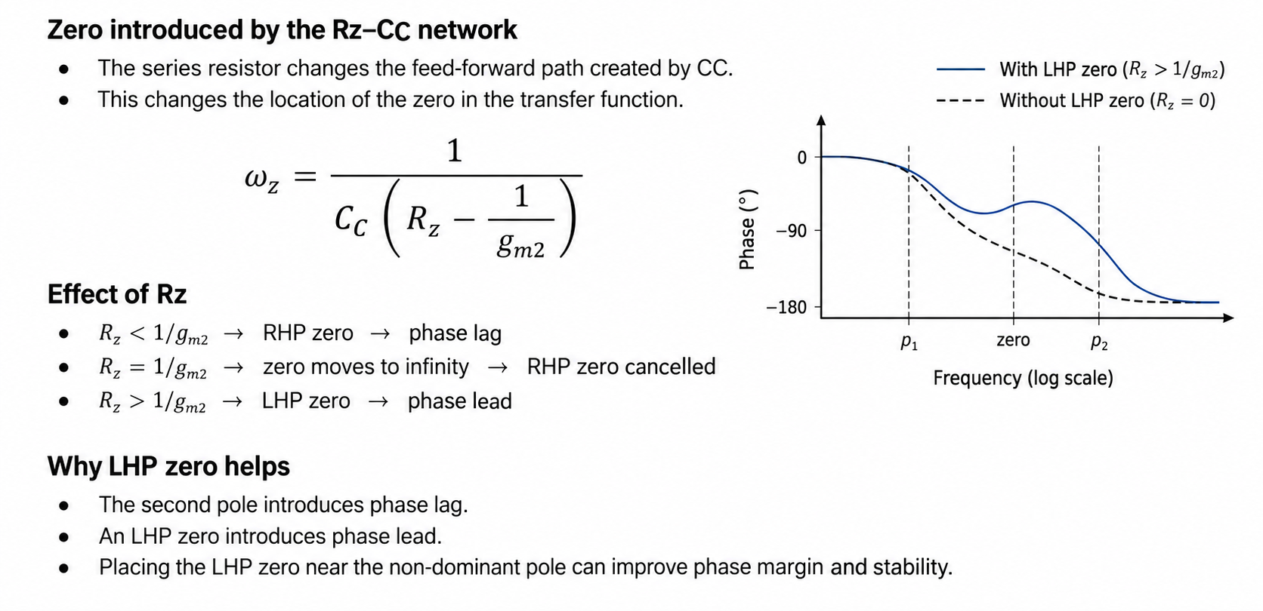
Effect of Rz on Zero Location and Phase

Slide 45
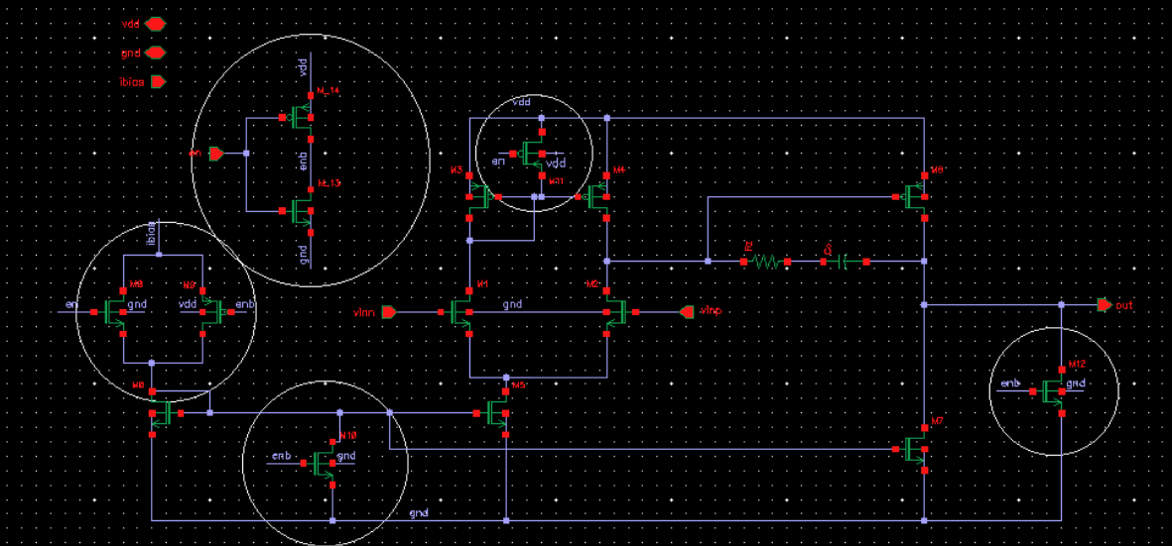
Schematic - Adding LHP zero
Switch
Inverter
Transmission Gate
LHP Zero
Switch
Switch

Slide 46
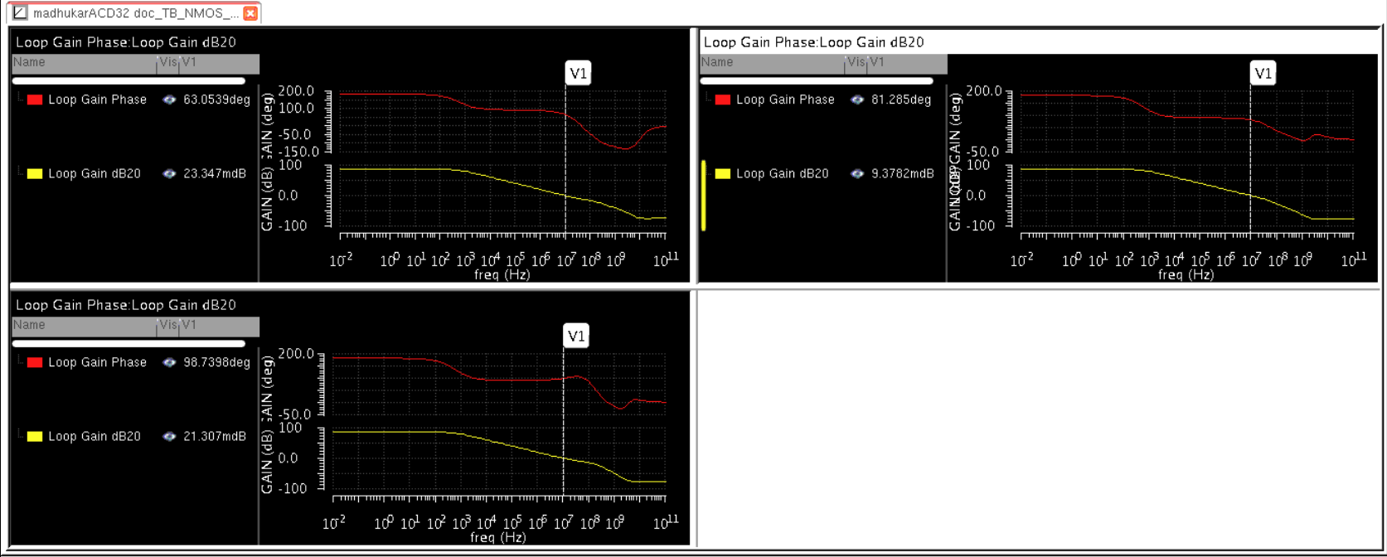
Simulation Results
Rz=0 Ohm
R_{z} = 0 Ω
R_{z} = 1K Ω
Rz=1k Ohm
R_{z} value | Phase Margin
R_{z} = 0 Ω | ≈ 63°
R_{z} = 1K Ω | ≈ 81°
R_{z} = 2K Ω | ≈ 98°
R_{z} = 2 K Ω
Rz=3k Ohm

Slide 47
Thank you

